Slide 1
Slashdot Social Network Analysis
BIA 658 Social Network Analysis
Nikitha Chunduru

Slide 2
Problem Statement
Analyzing the evolution of the global trade network and its impact on wealth distribution
Identifying key countries and communities in the network

Slide 3
Dataset Explanation
- Network of 6470 nodes and 4737 edges
- Nodes represent countries, edges represent trade relationships
- Data extracted

Slide 4
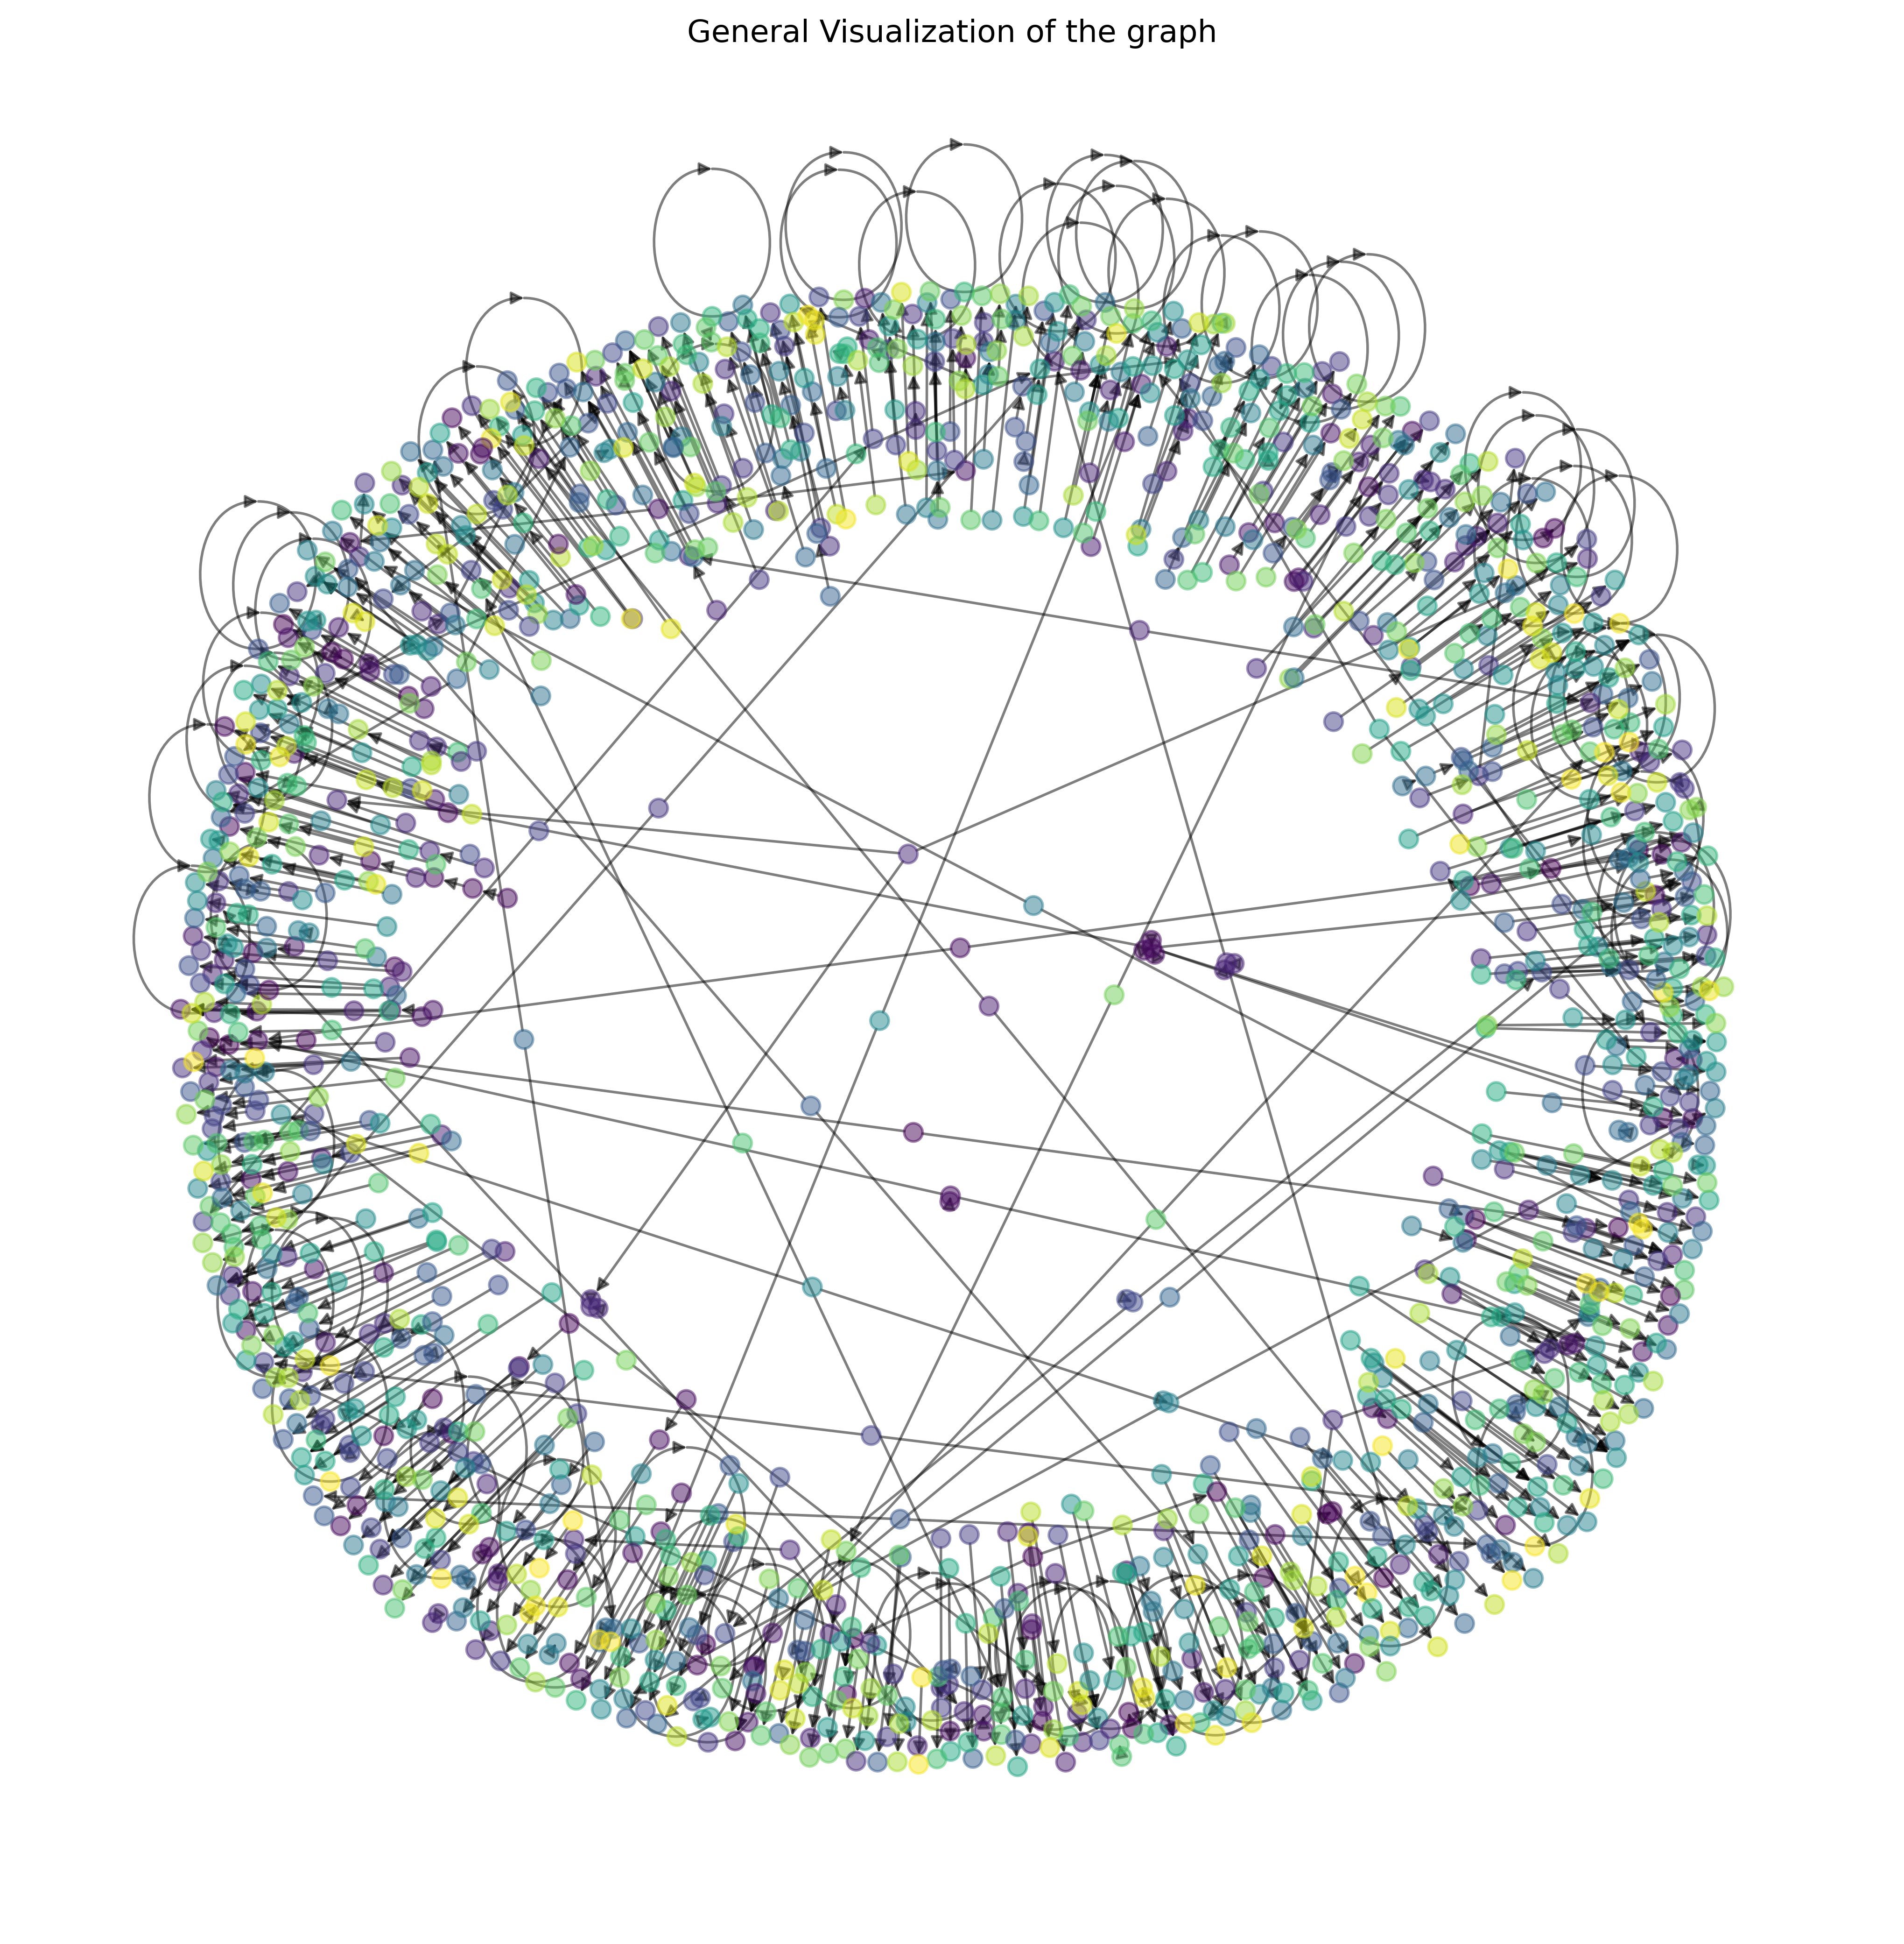
Descriptive Statistics (I)
Number of communities: 2170
Average in-degree: 0.73
Average out-degree: 0.73
Visualization: v-General Visualization of the graph.png

Slide 5
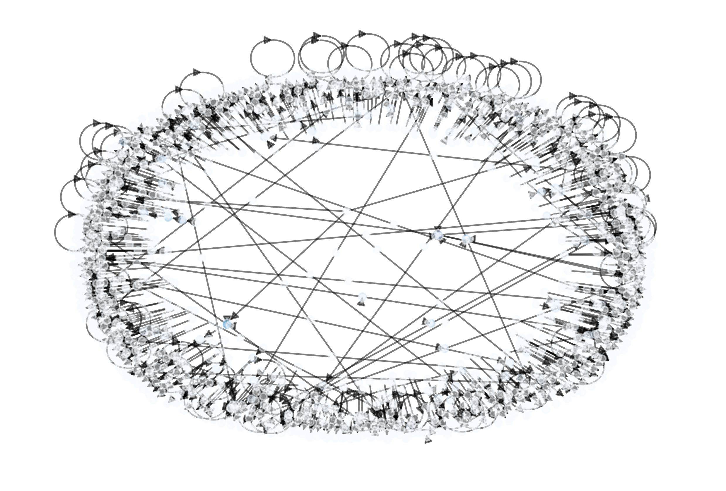
Descriptive Statistics (II)
Top 10 nodes by degree centrality
Top 10 nodes by betweenness centrality

Slide 6
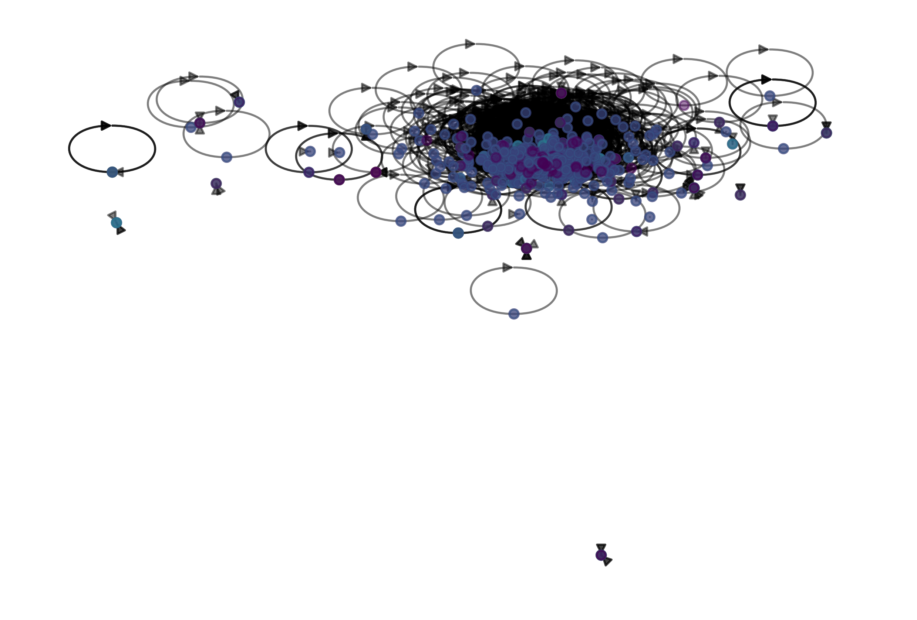
Descriptive Statistics (III)
Top 10 nodes by closeness centrality
Top 10 nodes by eigenvector centrality

Slide 7
Analytical Approach
Degree centrality analysis
Betweenness centrality analysis
Closeness centrality analysis
Eigenvector centrality analysis
Community structure analysis

Slide 8
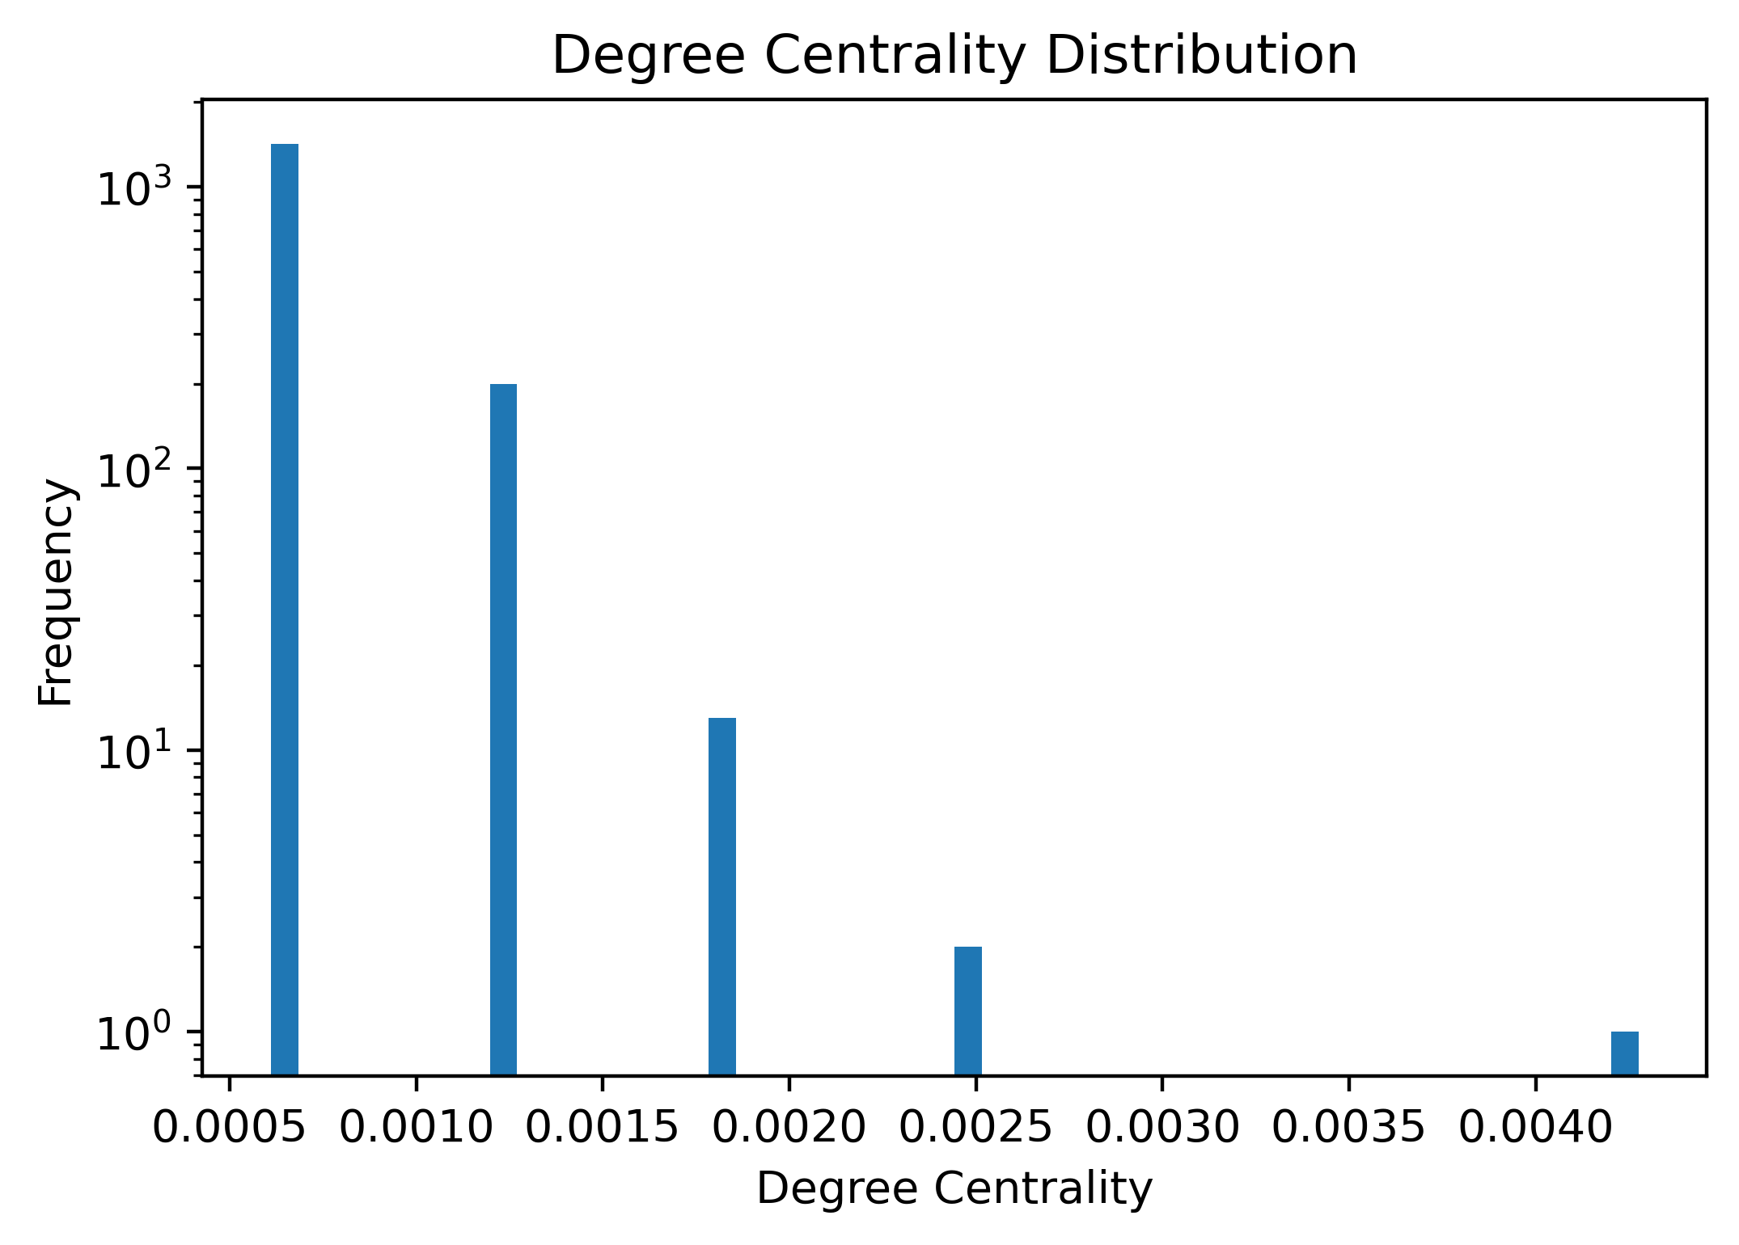
Degree Centrality Findings
Distribution of degree centrality values across the network

Slide 9
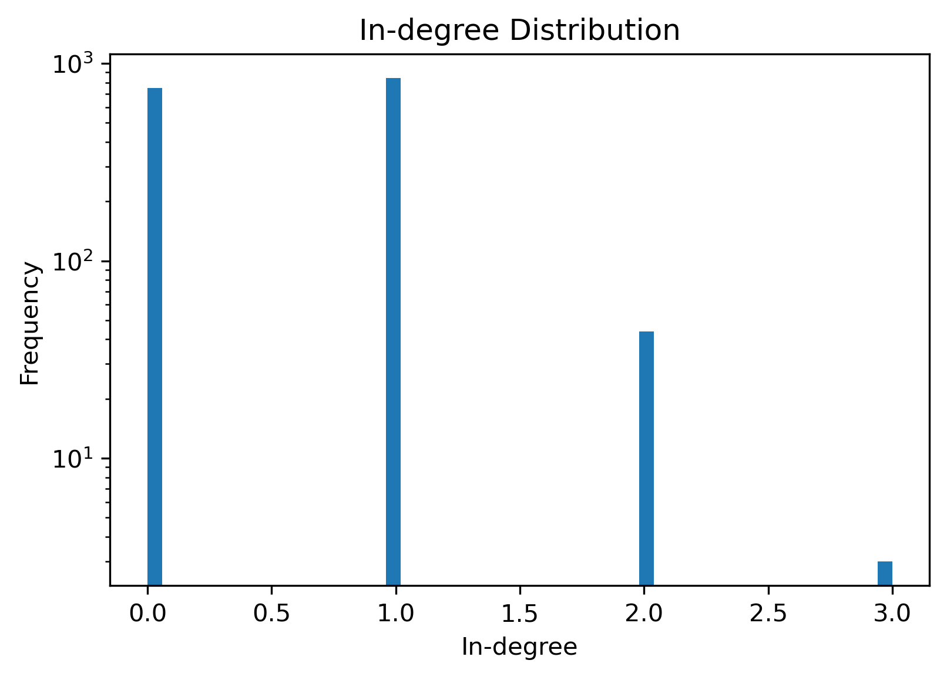
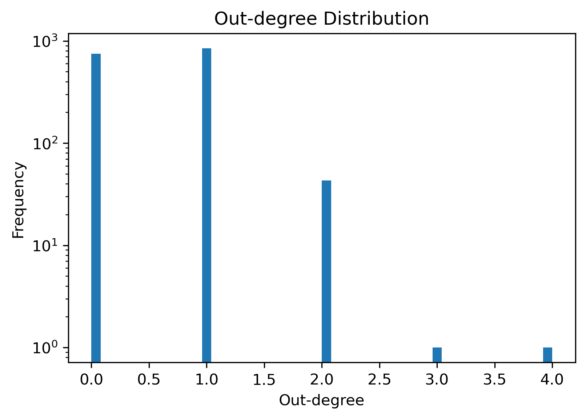
In-degree & Out-degree Findings

Slide 10
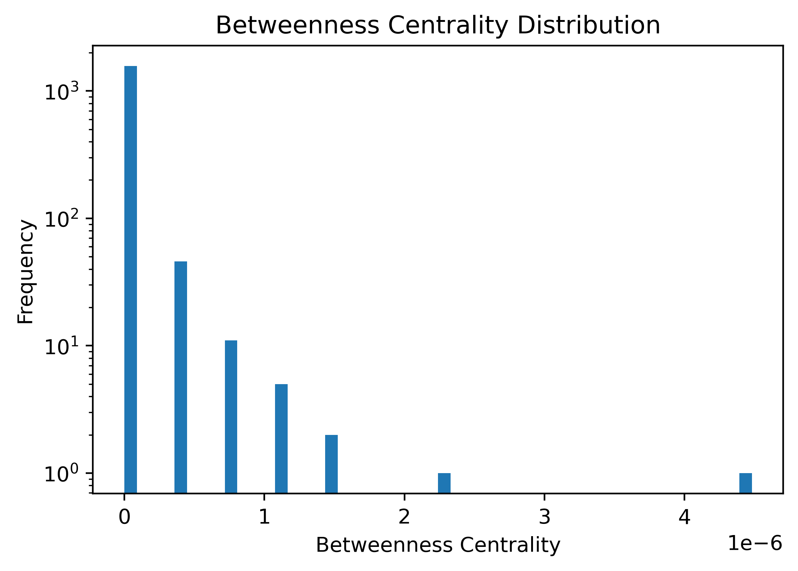
Betweenness Centrality Findings
Distribution of betweenness centrality values across the network

Slide 11
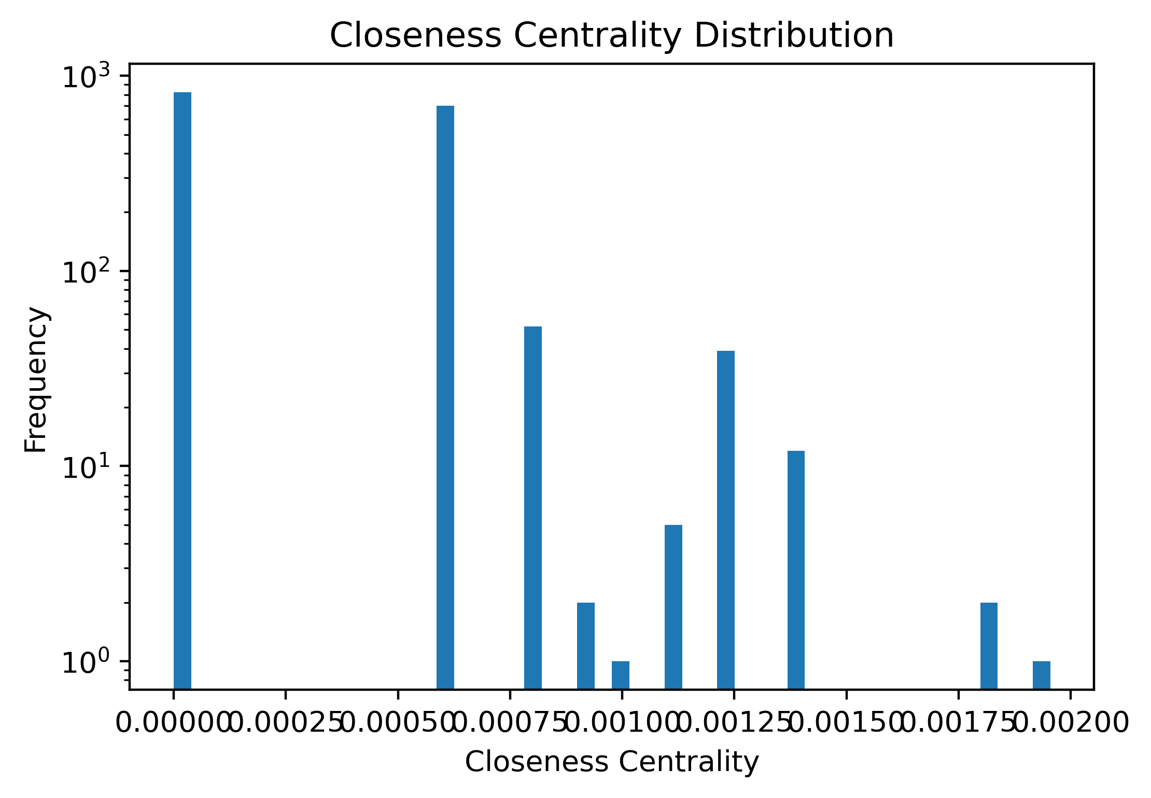
Closeness Centrality Findings
Distribution of closeness centrality values across the network

Slide 12
Community Structure Findings
Visualizing community structures within the network

Slide 13
Key Findings
Evolution of the global trade network over time
Decentralization of trade relationships
Persistence of wealth gap despite decentralization

Slide 14
Interpretations and Recommendations
Further investigate factors contributing to wealth gaps
Explore policies and strategies to promote more equitable trade relationships

